Slide 1
Power BI Project
Airline Data Management and Analysis
Presented by : Kavya Chakradhari

Slide 2
Problem Statement :
The airline industry operates with numerous complexities, requiring effective data management and insights into flight schedules, passenger details, and ticketing systems. This project aims to analyze airline operations for improving efficiency and customer satisfaction
Datasets Used:
Flight Information: Includes FlightID, FlightNumber, Airline, Destination, and Status.
Passenger Information: Includes PassengerID, FlightID, and SeatNumber.
3. Ticket Information: Includes TicketID, FlightID, and BookingStatus.

Slide 3
This project focuses on transforming raw Airline data into actionable insights by: Cleaning and preparing the data. Establishing relationships between datasets. Performing DAX calculations to extract key metrics. Creating interactive visualizations and dashboards. Implementing RLS and scheduled refresh for better accessibility.

Slide 4
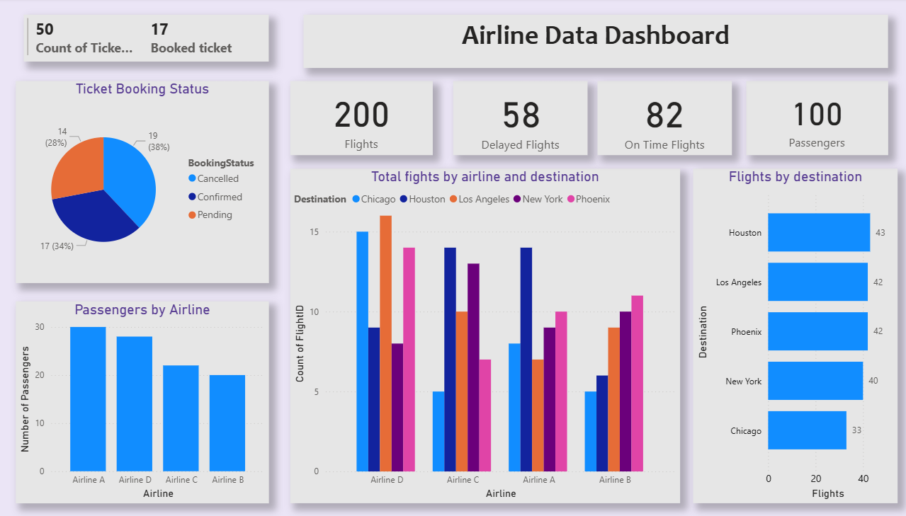
Dashboard

Slide 5

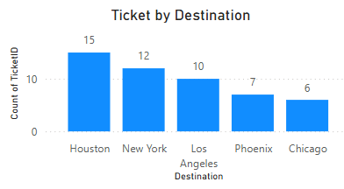
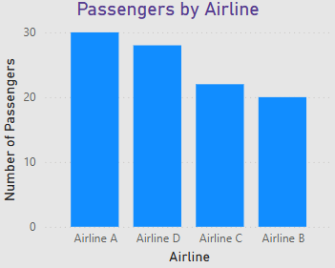
Key findings and insights from analysis The dataset have Total 200 Flights, Total 100 Passengers and Total 50 Tickets. There are total 50 tickets out of which 17 tickets are booked which contributes only 34% of total , 38% are cancelled tickets and 28% are pending tickets. Houston have maximum number of tickets and Chicago have minimum number of tickets. We have total four Airlines A,B,C and D in which Airline D have most number of Flights and Airline B have least number of Flights. Flights performance are based on Booking Status Classification from which 41% contributes in “best” classification and 59% contributes in “To be improved” classification.

Slide 6
Recommendations Focus on Flights classified as “To be improved” and investigate delays. Improve On-time performance. Identify peak booking period and adjust flight schedules accordingly. Enhance passengers experience by offering better flights services. Continuously monitor the interactive dashboard. Maintain regular data refresh schedule to keep report up to date.

Slide 7
Thank You !!

